Slide 1
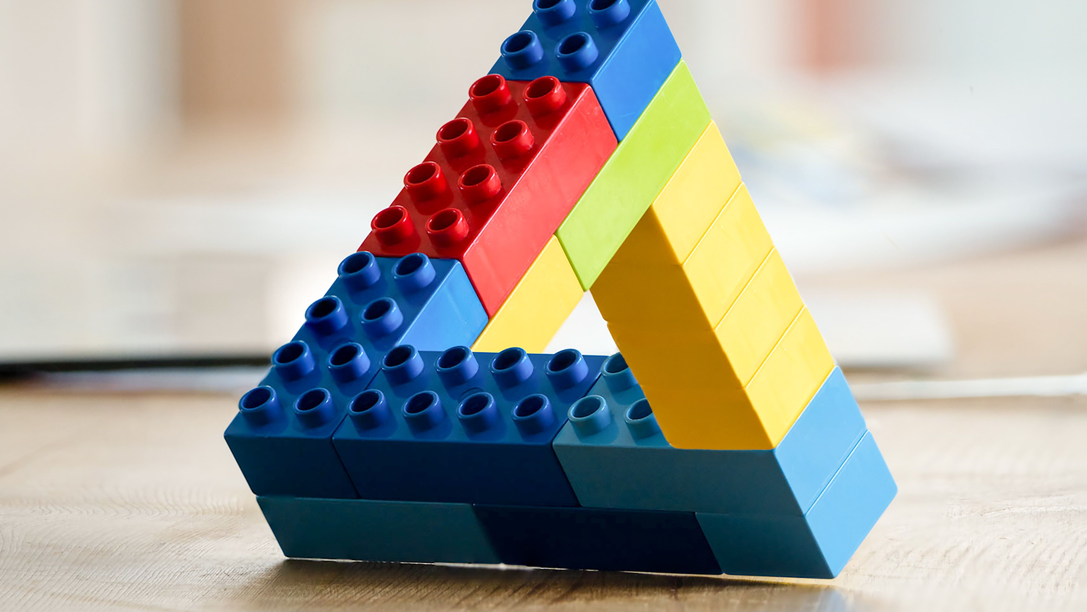
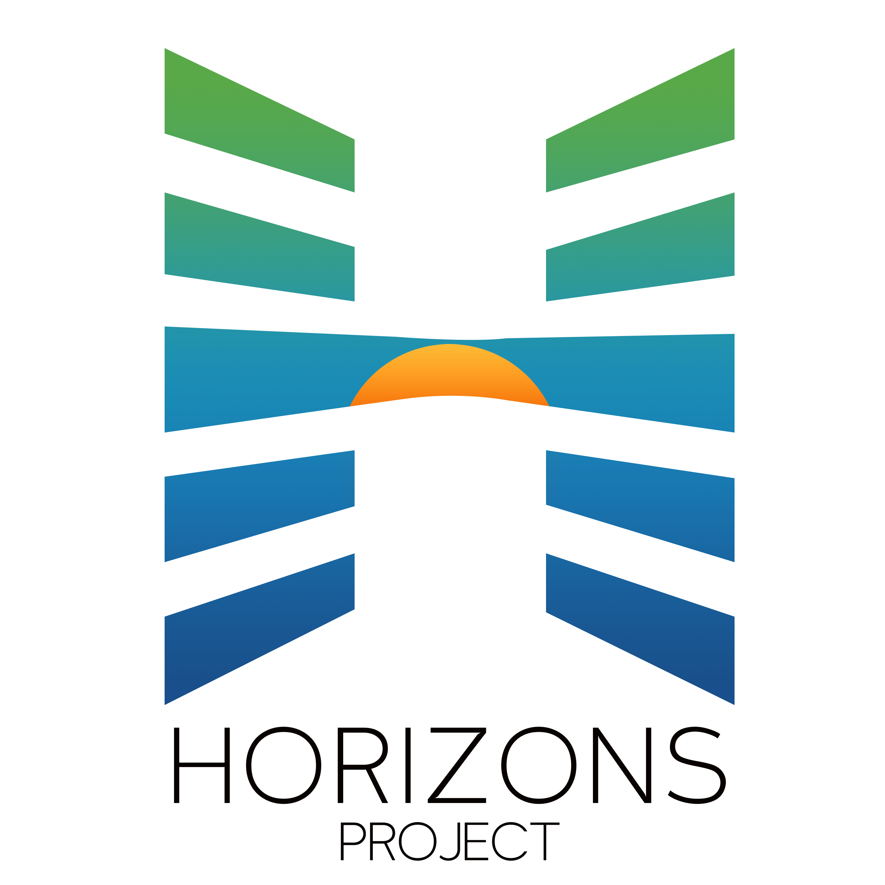
Block, Bridge & Build
Notes:
Brief introduction to Horizons and hello from JULIA to introduce Suparna

Slide 2
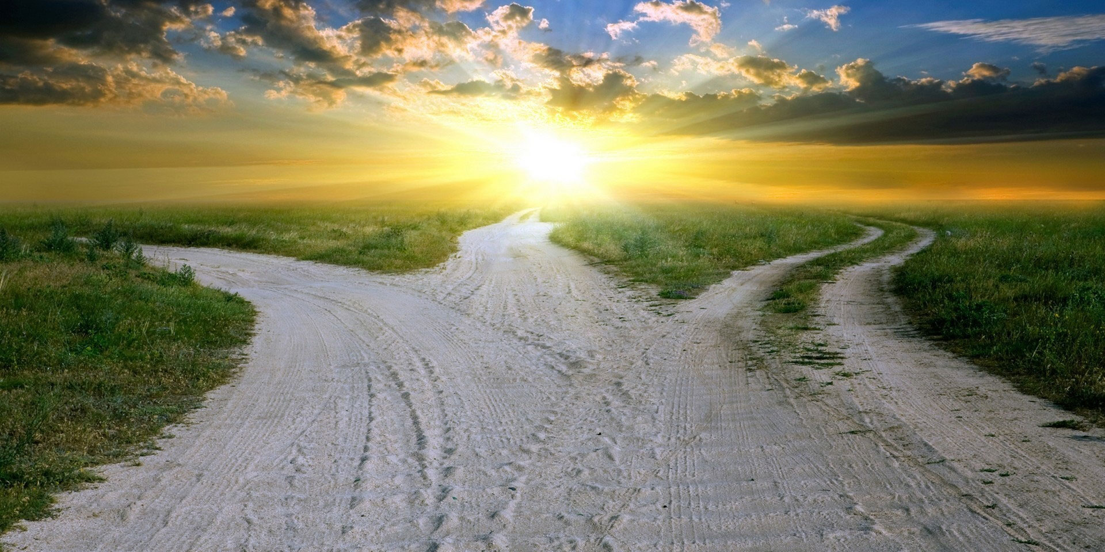

Notes:
Movement of movements need to be coming together - what do we want in our shared future? A vision where all belong and can flourish, where people have a say in the decisions that affect them the most. “Democracy & Belonging” MR. PID - several paths to get there but need to be working as a jazz band and not totally discordant. (How might we be able to work as a jazz band – pose as a question not as a hard sell.) THE MOVEMENT HAS DIFFERENT ROLES, we just need to be aware of the different roles instead of pushing against them…how do we take advantage of opportunities to alignment more. Loretta Ross - focus on the 90% of time when we’re aligned not the 10% when we’re not.
Why “paradox” ?? Because these are seemingly incompatible approaches to social change and/or actors with different theories of change that are in fact quite complementary. We may have different paths, but we are looking to reach the same end. How do we manage these tensions within our movements, within ourselves?

Slide 3

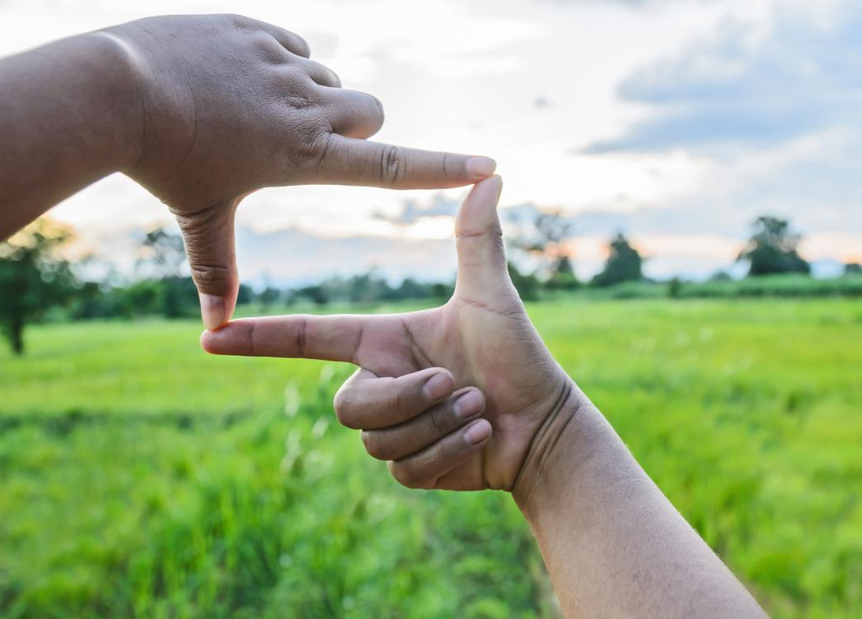

Notes:
We all make strategic decisions about where to put our energies and who to work with…priorities come into focus based on our lived experience, our positionality, our worldviews, the stories we tell ourselves about how the world works.
Purpose of session is to surface those frameworks and to see how they can be complementary, and how we can step into the natural tensions that different approaches may bring.
WHAT CHANGE DO YOU WANT TO SEE IN THE WORLD?!?!

Slide 4
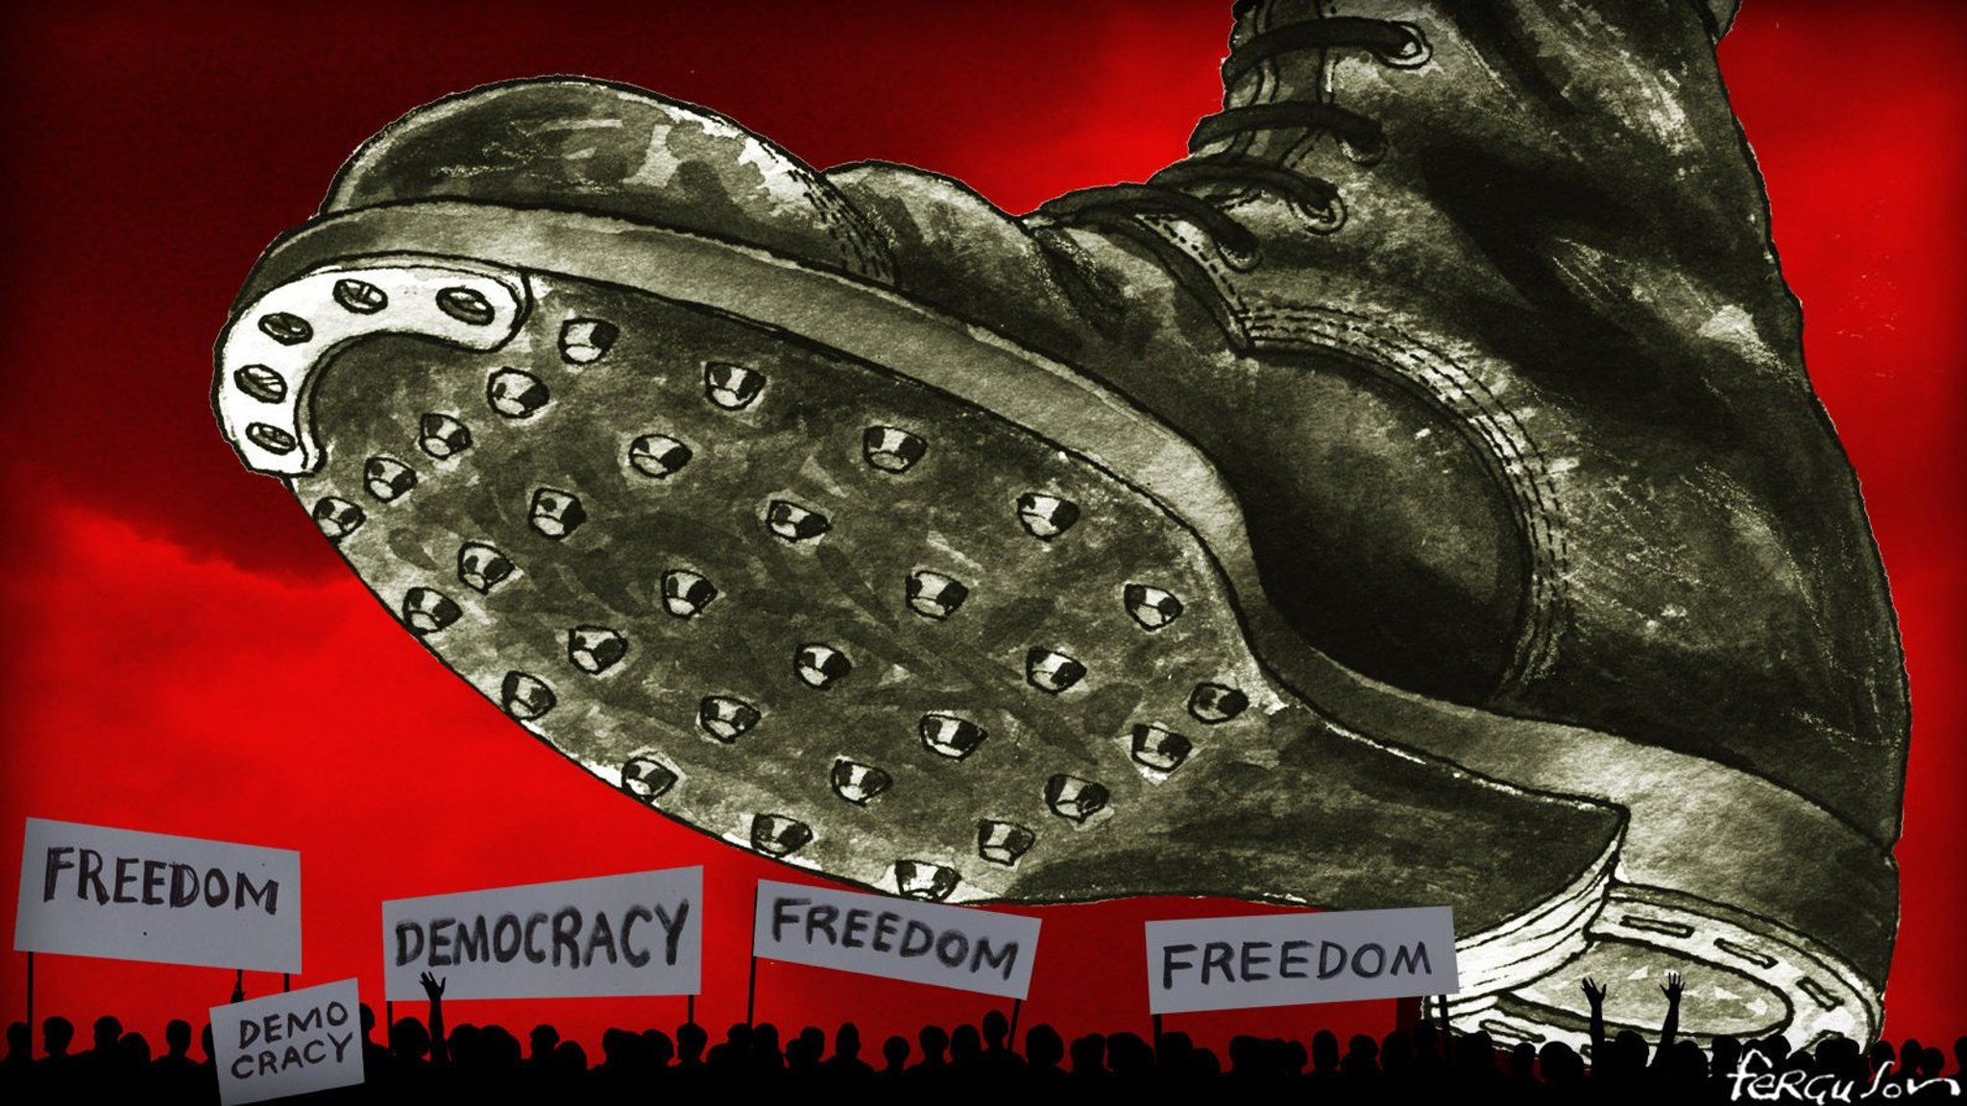
BLOCK
Notes:
“Block” the forces eroding democratic institutions and norms. Authoritarianism on the rise in the US and around the world. Playbook being wielded to great affect around the world.
Also blocking political violence! (preventing political violence, strategic backfire…a lot of overlap amongst the various approaches that aligns with all of your values.)
Divide and Rule
Dehumanization of other groups
Cause confusion & stow apathy
Demand loyalty, punish defectors
Racial authoritarianism has been with us in the US since the founding of our country. This is not a new phenomena. Civil Rights Movement in the 60s used various strategies and tactics to stand up against an unjust system.

Slide 5
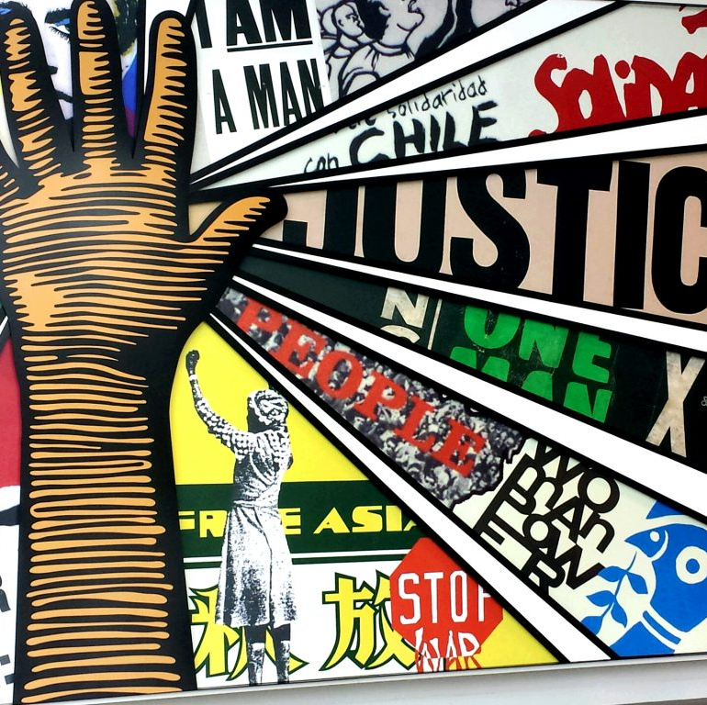
BLOCKING SKILLS & APPROACHES
Solidarity actions w/ those on the receiving end of harms
Creative/strategic nonviolent action
Disruption to bring attention to injustices – complacency is no longer feasible
Community safety & security
Organizing and mobilizing affected communities
Notes:
Going on offense! “RAISE THE HEAT”
Civil Resistance Framework & Strategic Nonviolent Action - this approach centers the needs of those suffering the most from injustices and raises the urgency to right power imbalances. It focuses on the structural and systemic nature of those injustices and seeks to mobilize collective action to stop harms to communities, those on the receiving end of the dehumanization and othering used for political gain.
Key power-building strengths
Raises the urgency and awareness of a key issue to make it “ripe” for addressing– DISRUPT COMPACENCY!!
Lessens the power imbalance to make it harder for those in power to avoid accountability, and stall
Builds a sense of belonging, solidarity and purpose through collective action.

Slide 6
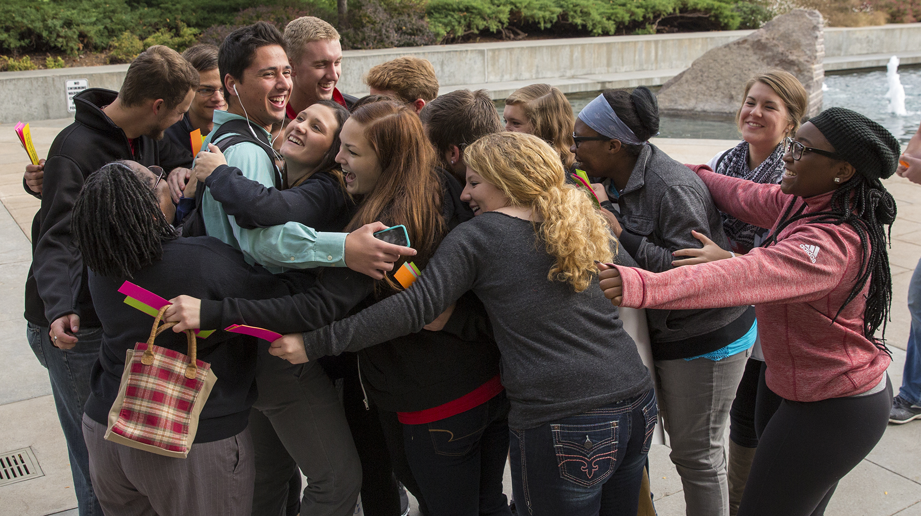
BRIDGE
Notes:
Bridge within society? Bridge within movements? Analysis of polarization as the main problem, or a symptom of purposeful political project to divide us?
- Do we need civic empathy and “civility” to problem solve together? Highlight the Concept of Negative Peace… explain why there is tension between bridging/pluralism frameworks that don’t take into account power and historic/current harms.
But bridging is needed! Inter-movement mediation.
Translating to other stakeholders in the spectrum of allies. Passive, etc.

Slide 7

BRIDGING SKILLS & APPROACHES
Deploying dialogue, mediation, negotiation, community cohesion-building tactics
Centering relationships and trust building, emphasizing curiosity and listening, finding common ground as first step to making change together
Bridge-building, creating space to build coalitions in the short-term amongst allies
Creating on-ramps for those not yet ready to be in a coalition in the long-term
Notes:
Our problem isn’t so much polarization as it is fragmentation. One of the impacts of the divide and rule tactics of an authoritarian regime trying to stay in power by toxic othering is that movements turn on each other. Fear makes us cleave to our in-groups and we are siloed in our issues/identities and fighting different fires as if they are isolated.
Bridge-building helps to establish meaningful connections among people from across social, economic, political, and other demographic and geographic divides. This approach centers relationship- and trust-building and emphasizes listening and finding common ground as a first step to working towards change together. Bridge-building can be used to build coalitions among allies in the short-term, while also creating space for others not yet ready to come to the table in the long-term.
Bridge-builders often use dialogue, mediation, negotiation, and other community cohesion-building tactics for the purpose of developing understanding, empathy, and relationships to find common ground and solutions on which communities can move forward together.

Slide 8
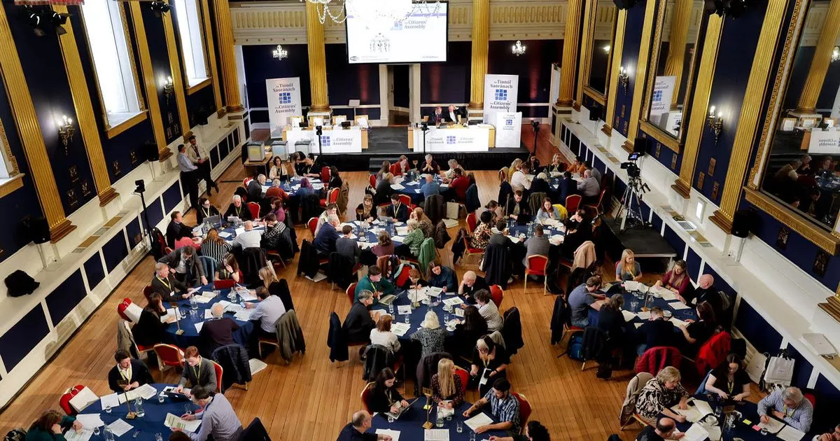
BUILD
Notes:
Building our future together is baked into both BLOCK & BRIDGE. We can’t just stand up for what we’re against, we have to stand up for what we’re for. And we can’t just bridge in a vaccum for the sake of empathy and understanding, effective bridge-building is centered around action and doing something together, not just talking - we have to bridge towards common goals and organize to do something about those goals.
BUILDING requires setting a vision of what’s possible, incorporating imagination skills of what could be possible, building is constructive – not just tearing down. There are many pockets of new ways of doing and building RIGHT NOW. The future is already here, it’s just unevenly felt/distributed.
Building societal cohesion and the society that we want! What we’re asking people to do is embody democratic practice, embody beloved community as we’re doing the work because it’s multi-generational work! We need to model what we want to see as we’re building. That’s the request we’re making as we build a pro-democracy movement!
Moving beyond disruption, a BUILD approach is also reinventing ways that society can function. Calling people forward into that shared vision - reforming institutions, fostering new leadership, investing in new generations – hospicing a dying way of life to birth a new shared future with dignity for all, abundance and belonging. Modeling how things can be by do it differently RIGHT NOW.

Slide 9
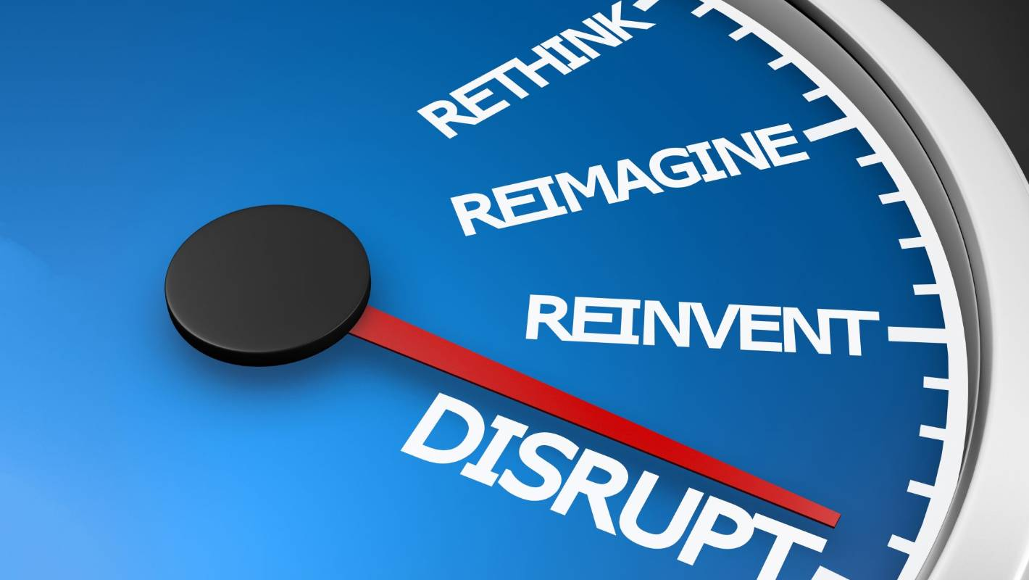
BUILDING SKILLS & APPROACHES
Visioning/Imagining/Futures Thinking of what is possible
Organizing with others – ‘what are we for’?
Generating something new through innovation
Noting that the future is now, ‘The future is already here, just distributed unevenly’
Calling people forward into a shared vision
Investing in institutional reform, leadership, modeling new ways of being and doing now

Slide 11
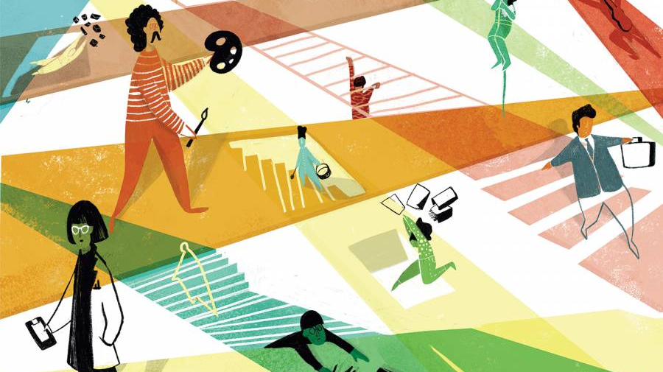
Notes:
What does this mean in practice? Not everyone has to do everything, not all of these approaches live in just one person or one movement, and they often overlap. But there are different emphasis that can cause tensions.
- For example on the timeframe for change: urgency and gradualism.
Also different emphasis on who is experiencing harm. Different levels of harm. For example, conservatives experiencing threats & intimidation, on the receiving end of political violence. This is degrading our democracy and needs to be blocked. Are they a part of a combatting political violence coalition - when people of color have been experiencing a form of political violence for generations? Whose pain and marginalization do we center in order to move forward together?
These are real tensions with implementing block, bridge, build…but also why we need all of them to confront the complexity of what we’re up against.
CLARIFYING QUESTIONS?

Slide 12
THANK YOU!
www.horizonsproject.us
Notes:
Focus on one specific campaign.

